Slide 1

SAP Analytics cloud training
Anubhav Oberoy
Day 12

Slide 2
Agenda – Day 12
Decision Making
Introduction to ML
Types of ML Models
Classification
Confusion Matrix
AUC and ROC Curve
Scenario
Notes:
Data Actions & Connections Basics
Data Actions in SAC
Introduction to Connections
Cloud Connector
Connecting to Import data with BW
Connecting to S/4HANA System
---Break---
Build CDS Views
Introduction to CDS View
Consume S/4HANA CDS views
Import data connection
Live Data connection with analytic Query

Slide 3

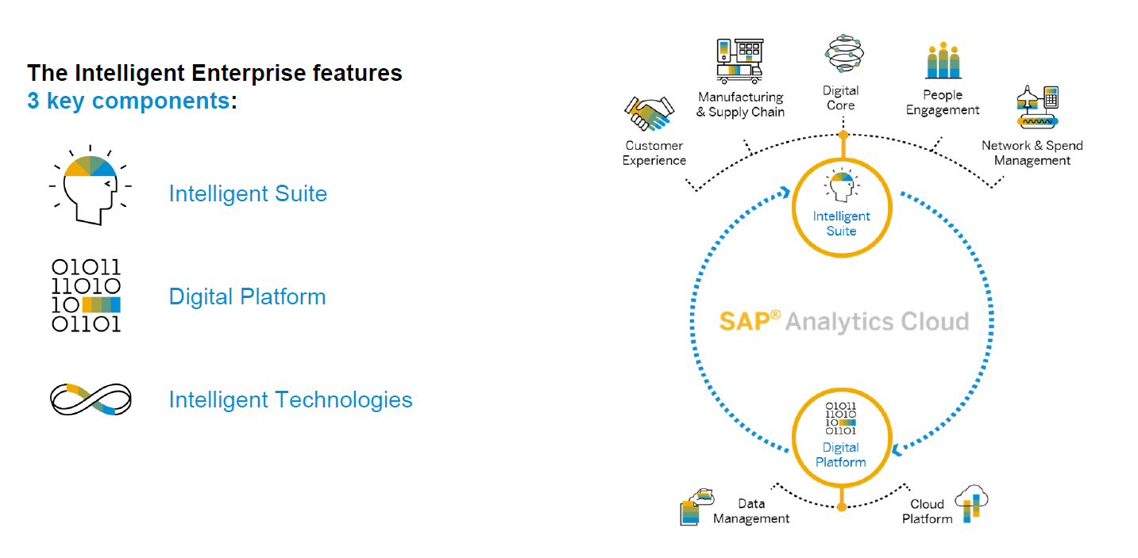
SAP Intelligent Enterprise Strategy
www.anubhavtrainings.com

Slide 4
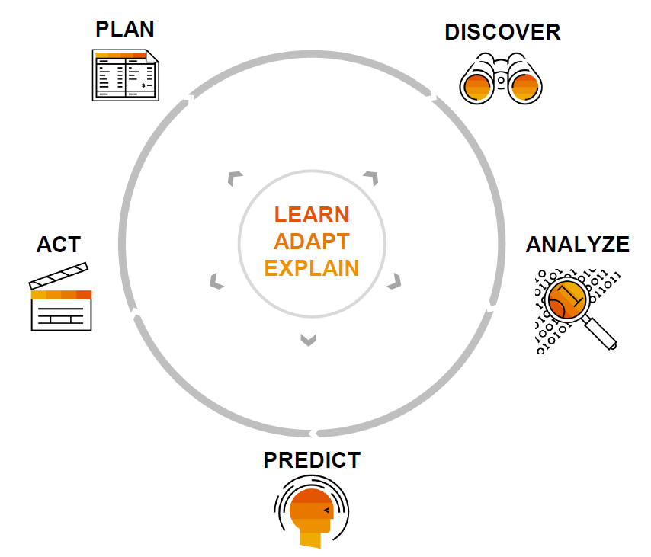
How decision making happens?
Employees
Act accordingly
Data engineer
Collect and track
Decision Makers
CEO’s office
Data scientist
analyze
Data scientist
Predict using models
www.anubhavtrainings.com

Slide 5

Introduction to ML (Machine Learning)
It is a field of study that gives computers the ability to learn by itself over the time based on business-critical data w/o being programming explicitly. E.g. Amazon, Netflix
data
Computer
data
Computer
output
Program
model
program
Expected output
www.anubhavtrainings.com

Slide 6










Example of ML
Marks | Result
9 | Pass
2 | Fail
3 | Fail
5 | Pass
8 | Pass
4 | Fail
7 | Pass
Computer
Machine learning tries to identify a rule/predictive model with highest accuracy
RULE
If Marks >= 5 Then
Passed
Else
Failed
Marks | Actual
3 | Fail
5 | Pass
7 | Pass
10 | Pass
2 | Fail
RULE
If Marks >= 5 Then
Passed
Else
Failed
Marks | Predicted Op
3 | Fail
5 | Pass
7 | Pass
10 | Pass
2 | Fail
www.anubhavtrainings.com

Slide 7
Predictive Model (Rule) Techniques
Modeling is a process by which machine learning tries to create/find the best model for our use case. The model is created to predict an outcome. Model evaluation is an integral part of this process. In order to find the best predictive model, computer will use different algorithms. Broadly there are 2 ways to build this model
Hold out technique (Large datasets)
The entire dataset (where outcome is known) is split into 2 parts. First part is called training dataset and second part is called validation dataset. With the help of training dataset, we train the computer by applying different algorithms. Based on the second part, we validate if the data predictions are accurate or not and determine the accuracy. We do this for multiple algorithms and the one which gives best accuracy, we will take it forward.
Cross Validation (Small datasets)
When we have limited set of data, to achieve an unbiased estimate of model performance, we use cross validation. We divide data into smaller chunks called k’s. Each k will be used for sampling and then we change the pair with another.
www.anubhavtrainings.com

Slide 8
Types of machine learning
Supervised learning
Train our model using training dataset → predictive model, retry, retrain
Algo – Decision tree, native bayes, logistic regression, Linear/Multi Regression, SVM…
Scenario – Regression and Classification are the examples of Supervised ML.
Unsupervised learning
Let machine work on the dataset like a child to explore this data and make a predictive model.
Algo – K-Means, Hierarchical, Apriori, Generic Algo, Trend Analysis
Scenario – Segmented time-series
Re-inforement learning
Candy-stick approach
Reobotics
www.anubhavtrainings.com

Slide 9
Difference Analytics v/s Predictive Analytics
Analytics – it is used to create visualization based on the historic data which will give us the insight. Just as as-is state.
Predictive Analytics – When we want to predict the future, we use predictive analytics. This will happen by creating predictive models. We get the vision.
The prediction will be done based on the past events and experiences to take us to the future. Hence it is extremely important that the quality of the data provided to computer is correct.
Before we apply machine learning, we need to ask 3 questions
Business need
Business Goal
Output Expected by decision we make
SAC offers 3 types of ML Scenarios
Classification
Regression
Segmented time-series
Which scenario to use?
www.anubhavtrainings.com

Slide 10
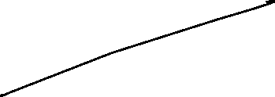

Classification Scenario
Scenario – I want to run a marketing campaign, the no. of leads in my system are huge. If I run my marketing campaign considering that all the students will buy my course, I will end up spending huge cost. The cost to acquire a customer is very high. Our goal is to find out of all the students (population) which are all the one’s which will respond positively.
E.g. total population – 10mn
Cost to send marketing campaign is 1 $ = 10 mn$
I only have 2 mn$,
In this case we divide the population into 2 categories
1 – Positive responder
0 – Non responder
We want to classify these 10mn with a probability to respond positive to my campaign. When the problem addresses to classify the population into a out come of bi-nominal (1 or 0), it is called as classification problem and we use classification scenario.
Price of my house ---- No (is continuous nature)
A patient has corona or not ---- Yes
Predict the price of my share ---- No
If a customer will churn or not ---- Yes
www.anubhavtrainings.com

Slide 11

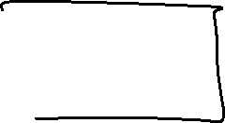









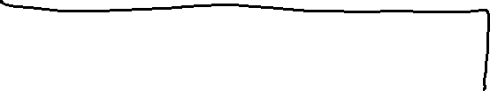
Concept of Dependent and Independent variable
Requirement – Based on health checks of patients we want to predict if the patient will develop a heart disease or not.
Independent variables – in a data set the data which is used to calculate the outcome are called independent variables
dependent variables – the outcome which depends on independent variables.
Chest Pain | Good Blood Circulation | Sugar | Weight | Has HEART disease?
YES | NO | YES | YES | YES
NO | YES | NO | NO | NO
YES | NO | YES | NO | YES
YES | NO | NO | NO | NO
NO | YES | NO | YES | NO
www.anubhavtrainings.com

Slide 12
Determine Accuracy
Suppose we applied different algorithms to get predictions. How to determine, which model is best for our use case based on our dataset.
There are different ways to find the best model among others based on accuracy
Confusion Matrix
ROC Chart
AUC Curve
www.anubhavtrainings.com

Slide 13



What is confusion matrix
A confusion matrix will be used avoid the confusion of which is the best model. I did sampling of 200 patients and provided a validation datasets to a model. The model predicted some patients as heart patients, and some are not heart patients. No we write a confusion matris to compare the validation dataset with predicted outcome
Sampling of 200 patients | Actual 1 | Actual 0
Predicted 1 | 70 (True Positives) | 20 (false positive)
Predicted 0 | 30 (False Negative) | 80 (True Negative)
www.anubhavtrainings.com

Slide 14









ROC Curve (Receiver Operating Characteristics)
It is a curve between TPR and FPR which was calculated by ML after calculating the Confusion matrix.
Validation, log. Reg
Training, log. Reg
1
Tree Algo
TPR
0
0
FPR
1
Robustness – Difference between training and validation.
www.anubhavtrainings.com

Slide 15










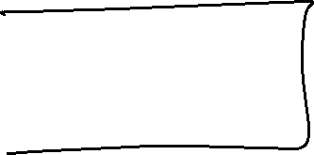











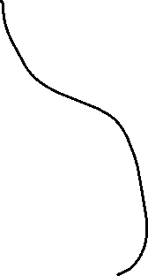

Embedded SAC
www.anubhavtrainings.com

Slide 16
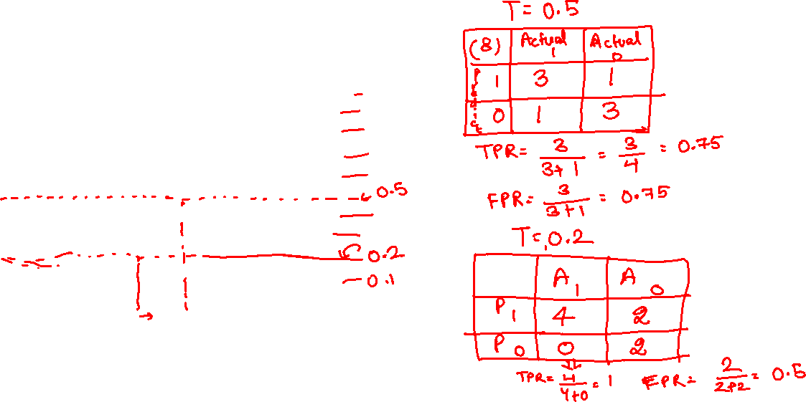
Example of regression
Has heart disease or not
1
0.9
0.8
0.7
0.6
0.5
0.4
0.3
0.2
0.1
0
weight
Blue – he is actually heart patient
Red – He is not heart patient
www.anubhavtrainings.com

Slide 17
Try yourself ☺
Has heart disease or not
1
0.9
0.8
0.7
0.6
0.5
0.4
0.3
0.2
0.1
0
weight
Blue – he is actually heart patient
Red – He is not heart patient
www.anubhavtrainings.com

Slide 18
Confusion Matrix for the different Threshold
Threshold Value: 0.1
Threshold Value: 0.2
Threshold Value: 0.3
Threshold Value: 0.4
Actual→ Predicted | Is fat 1 | Is not fat 0
Is Fat 1 | 4 | 4
Is not fat 0 | 0 | 0
Actual→ Predicted | Is fat 1 | Is not fat 0
Is Fat 1 | 4 | 3
Is not fat 0 | 0 | 1
Actual→ Predicted | Is fat 1 | Is not fat 0
Is Fat 1 | 4 | 2
Is not fat 0 | 0 | 2
Actual→ Predicted | Is fat 1 | Is not fat 0
Is Fat 1 | 3 | 1
Is not fat 0 | 1 | 3
→
→
→
→
(TPR, FPR) 1,1
(TPR, FPR) 1,0.90
(TPR, FPR) ,1,0.75
(TPR, FPR) 1,0.5
Threshold Value: 0.7
Threshold Value: 0.8
Threshold Value: 0.9
Threshold Value: 1
Actual→ Predicted | Is fat 1 | Is not fat 0
Is Fat 1 | 3 | 0
Is not fat 0 | 1 | 4
Actual→ Predicted | Is fat 1 | Is not fat 0
Is Fat 1 | 2 | 0
Is not fat 0 | 2 | 4
Actual→ Predicted | Is fat 1 | Is not fat 0
Is Fat 1 | 1 | 0
Is not fat 0 | 3 | 4
Actual→ Predicted | Is fat 1 | Is not fat 0
Is Fat 1 | 0 | 0
Is not fat 0 | 4 | 4
→
→
→
→
(TPR, FPR) 0.75,0.25
(TPR, FPR) 0.75,0
(TPR, FPR) 0.5,0
(TPR, FPR) 0,0
www.anubhavtrainings.com

Slide 19
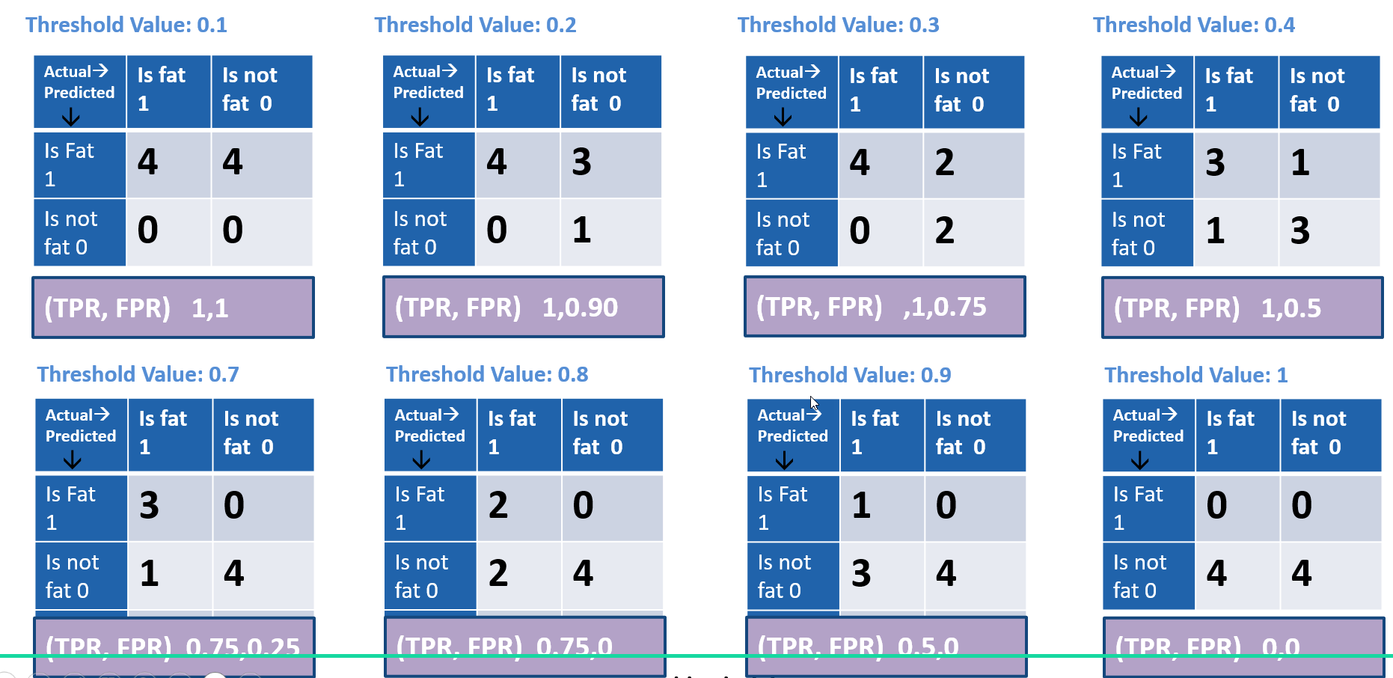



Title
Logistic reg.
1,0.5
1,0.75
1,0.90
1,1
1
0.75,0
0.75,0.25
TPR
Native bayes
ROC Curve
Is to determine which threshold level is giving the best result for our scenario. Rather looking at large no. of confusion matrixes, we can just look at ROC curve.
AUC Curve
Determine which Area under curve is best for our scenario.
0.5,0
0
0,0
1
0
FPR
www.anubhavtrainings.com

Slide 20
Profit Simulation
12.4% employees were contacted, and we can detect 49% positive target
If we contact 258 employee, we can detect 126 employees who has high probability to leave the organization.
Total number of employees = 8000
If we not had ML
Contact 12.4% employees = 8000 * 12.4 = 992 Employees I need to contact if I not have ML
Cost to contact them = 992 * 1$ = 992 $ is what I spent
Profit with out ML = 992 * 10.625 % = 106 employees
Saving = 106 * 10$ = 1060 $
Net Saving = 1060 – 992 = 68$ I save if I randomly contact 12.4% employees
Based on SAC Results
Number of contacts = 258
Cost = 258 *1$ = 258$
Savings = 126*10$ = 1260 $
Net Saving = 1260 – 258 = 1002 $
Extra = 1002 – 68 = 934 $ extra you are saving
1373% extra saving you have with SAP SAC.
www.anubhavtrainings.com

Slide 21















Title
<>
1
1
2
0
www.anubhavtrainings.com

Slide 22
End of Day 12

Slide 23

Questions

Slide 24

Anubhav Oberoy
anubhav.abap@gmail.com

